Slide 1


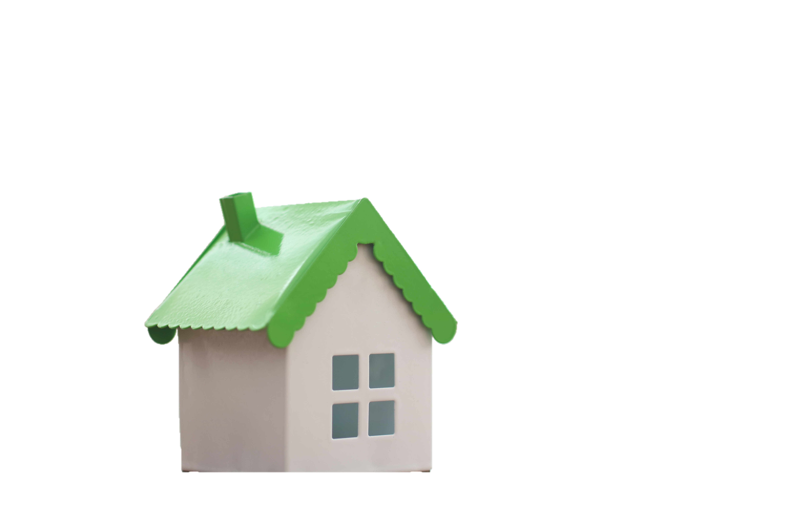
Real Estate
Market Analysis
Project Report - Spring 2023
BAN 612 - Data Analytics
Group-3
Feb 26, 2023

Slide 2




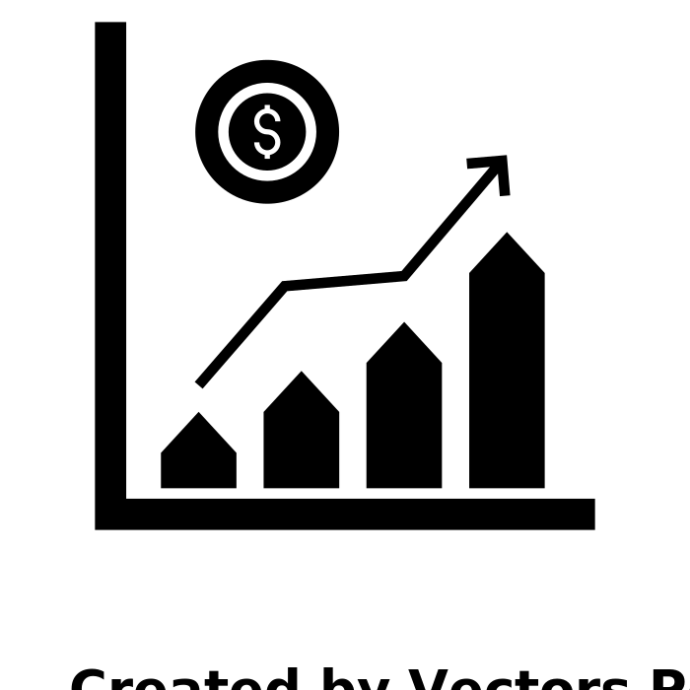





Contents
Team Introduction
Project Overview
Data Collection
Exploratory Data Analysis
Predictive Analysis

Slide 3
Project Team Members
Parthiv Patel
NetId - hk9113
Swati Sharma
NetId - xn2486
Megh Dave
NetId- cc3118
Sam Thomas
NetId - my4704
Akhil
NetId - to6616

Slide 4



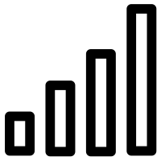
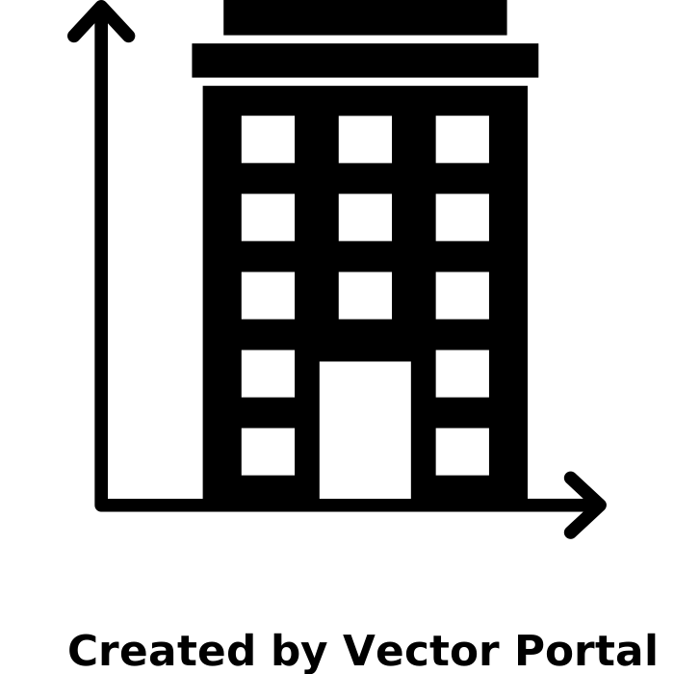
Project Overview
Technologies
Problem Statement
The housing price or rental price in San Francisco Bay Area accelerating at shocking rates. From 2010 to 2017, the median price of a single family home in San Francisco has gone from approximately & 775,000 to $1.5 million. This project presents detail analysis on the real estate in San Francisco Bay area region.
To collect information on more than 600 distinct properties from Redfin Real Estate website
To clean, prepare, organize and handle the missing data, outliers,incorrect record and so on
Prepare a statistical report to analyse the current trend in the market for real estate
Propose several research questions and use visualization techniques to identify the researched questions
Data Resources
Attributes
Redfin Real Estate - https://www.redfin.com
State
Price
Status
Area

Slide 5

Part 1:
Data Collection

Slide 6







Flowchart - Web Scraping Steps
Selenium Automation
Identify the type of data
Data Collection
Convert the data into
Bot opens the website and locates the required attributes
Extracts the required attributes
Repeat the same process till the last page
Attribute Classification
HTML Parser
Identify the type of data
Data Collection
Convert the data into
Use of custom header to avoid html content backlog
Identify html tags for required attributes
Extract the tag’s content and repeat the same process for all pages
Attribute Classification

Slide 7
Data Cleaning - Before vs After
Data Cleaning Process:
We extracted over 1200 data from six different county having six different pages. After cleaning, the total data boiled down to around 430.
Data is cleaned by removing null values, by making function to split all alphanumeric data into categorical and quantitative columns for exploratory analysis and prediction.
Column Attributes | Before Cleaning | After Cleaning
Price | 598,000 | 598000.0
Lot_Area | 5,200 Acres | 5200.0
HOA Due | $449 | 449.0
Redfin_estimate | 498,286 | 498286.0

Slide 8
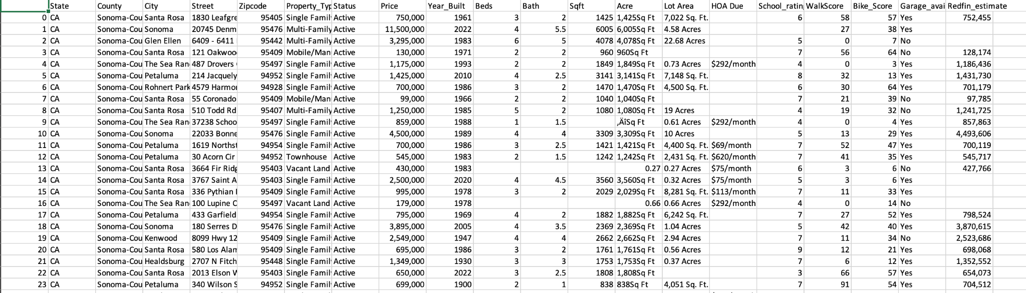
Final Result

Slide 9
Exploratory Data Analysis

Slide 10
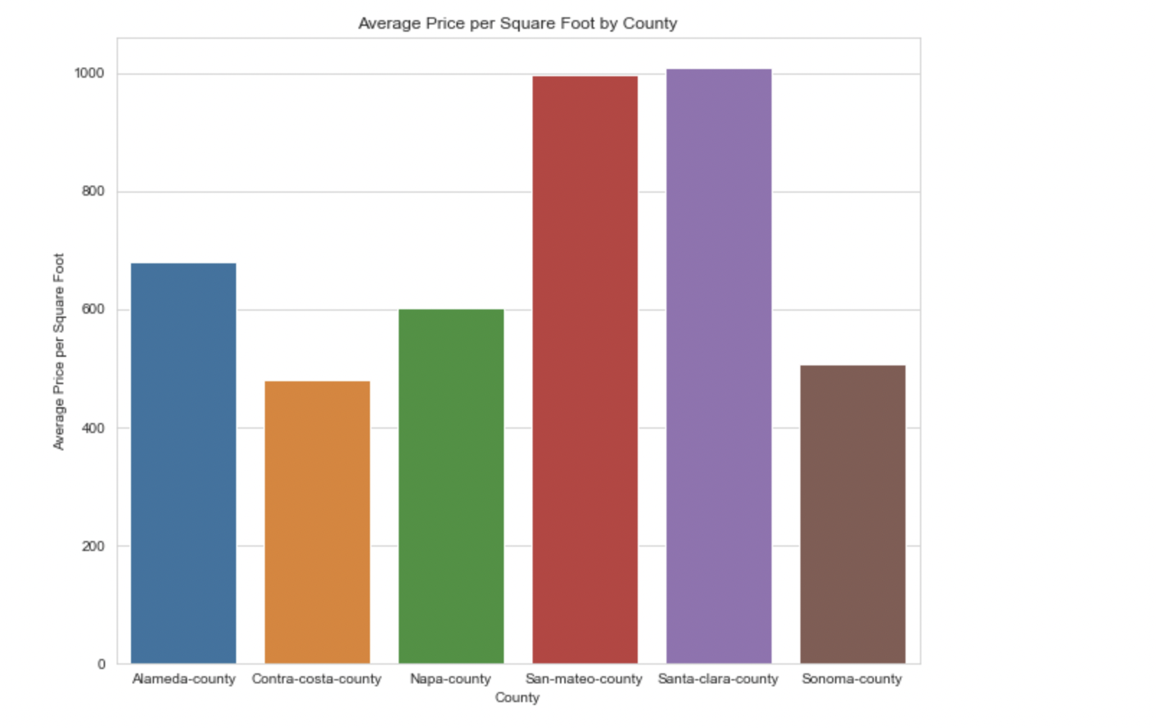
Santa-clara county has the highest per sqft price in the bay area which is followed closely by san-mateo county
Contra-costa county has the lowest per sqft price in the bay area which is less than half the price per sqft of Santa-Clara or San-Mateo counties.

Slide 11
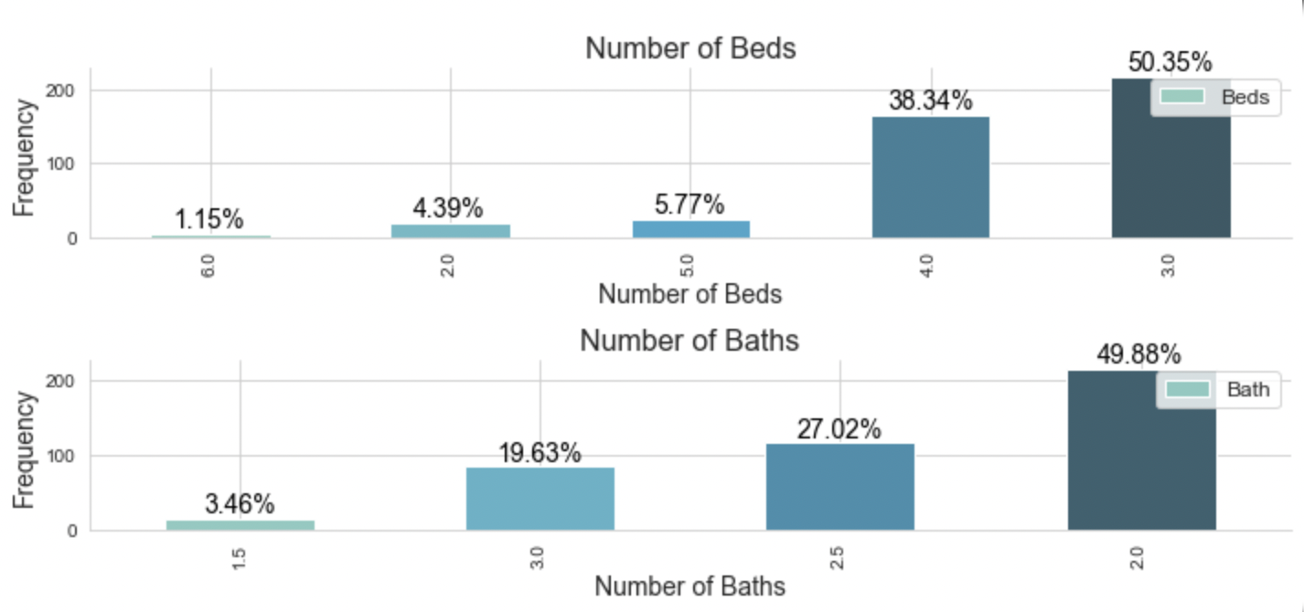
Houses with 3 bedrooms are the most common among the listings at over 50%. Additionally, houses with 2 baths are also highly frequent in our data with almost half of all listings.
Least in numbers are apartments with 6 bedrooms and 1.5 baths

Slide 12
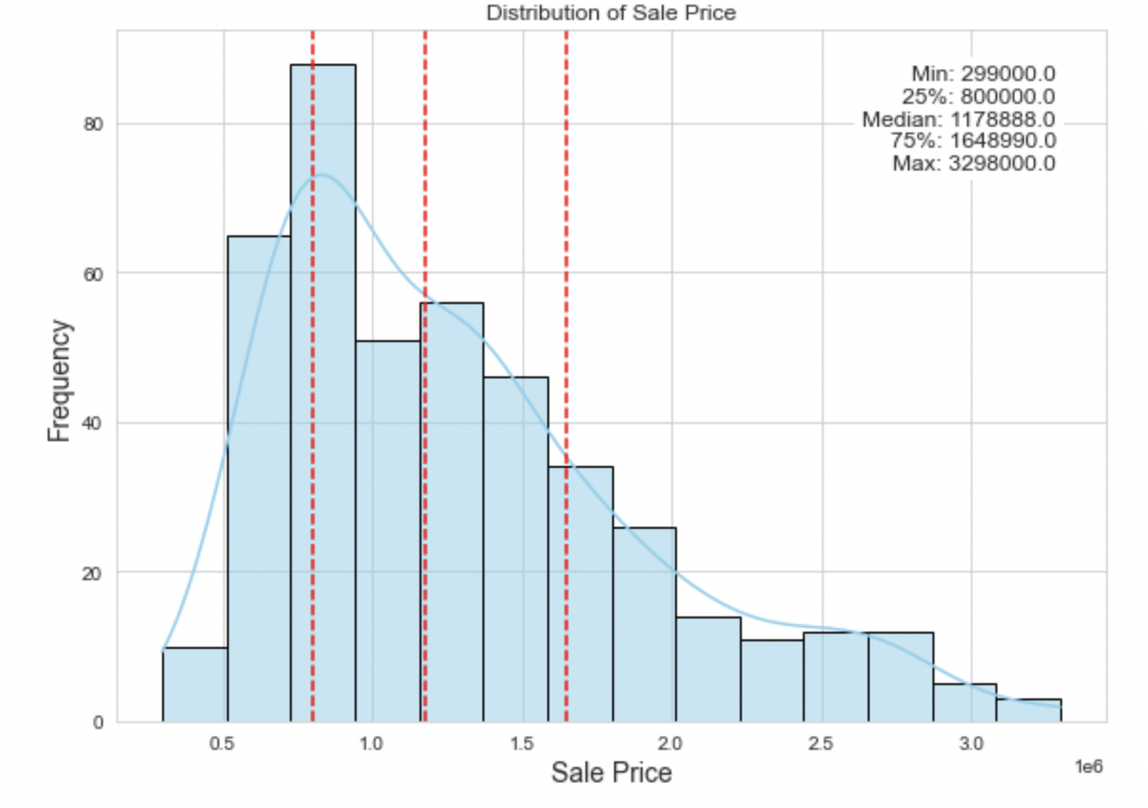

Slide 13
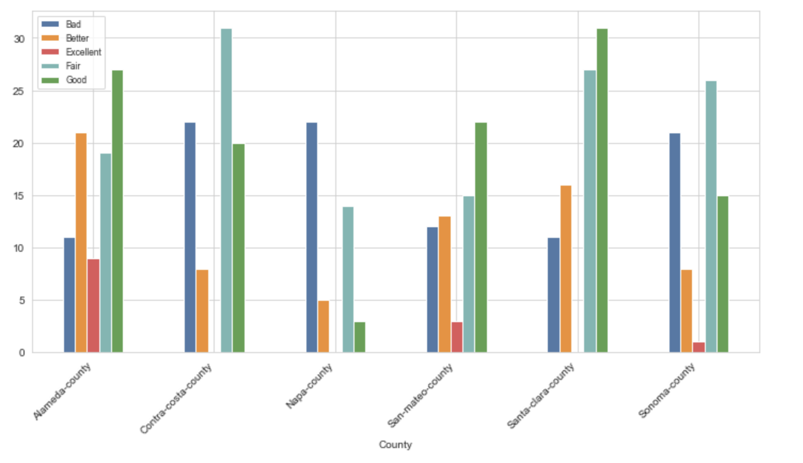

Slide 14
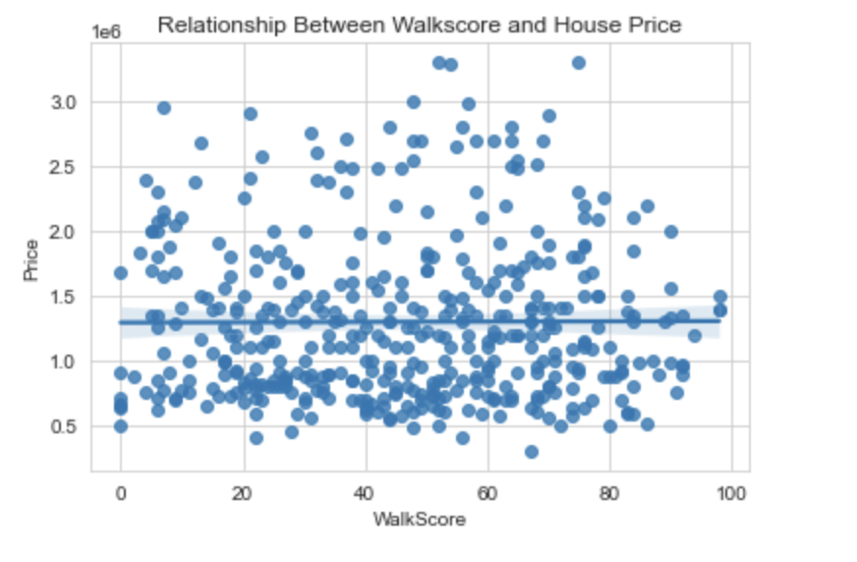
A correlation value of 0.004694 means that there is a very weak positive correlation between Walkscore and House Price.
This value is close to zero, which means that there is almost no linear relationship between the variables.

Slide 15
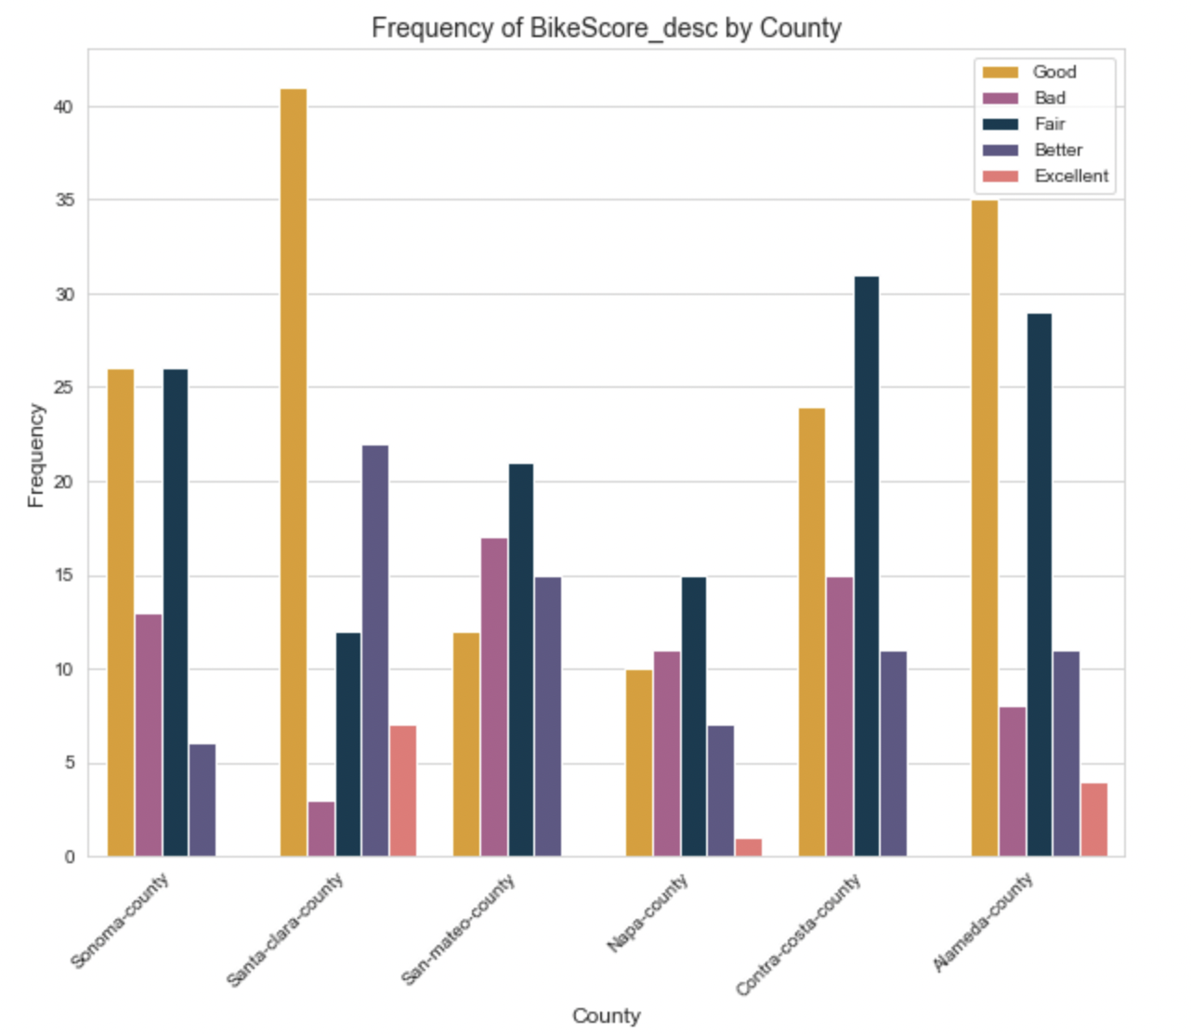
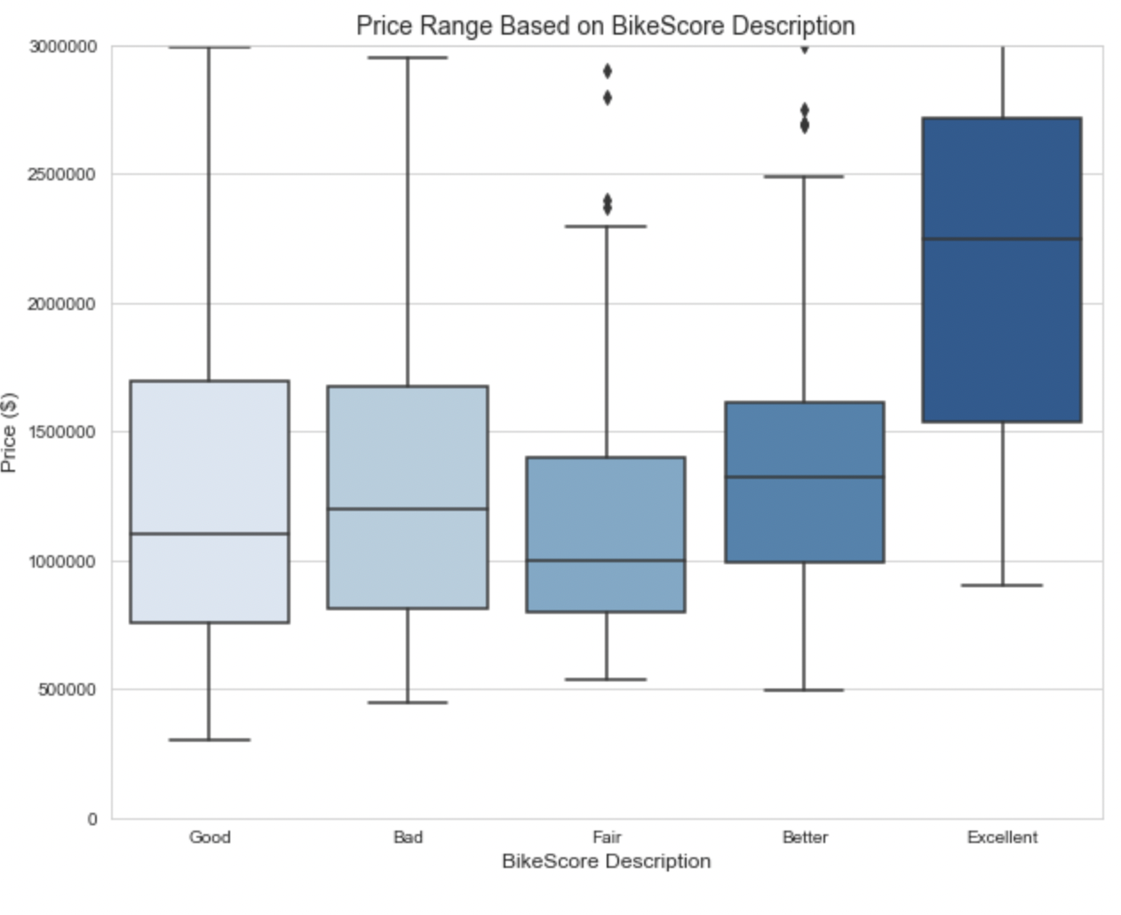

Slide 16
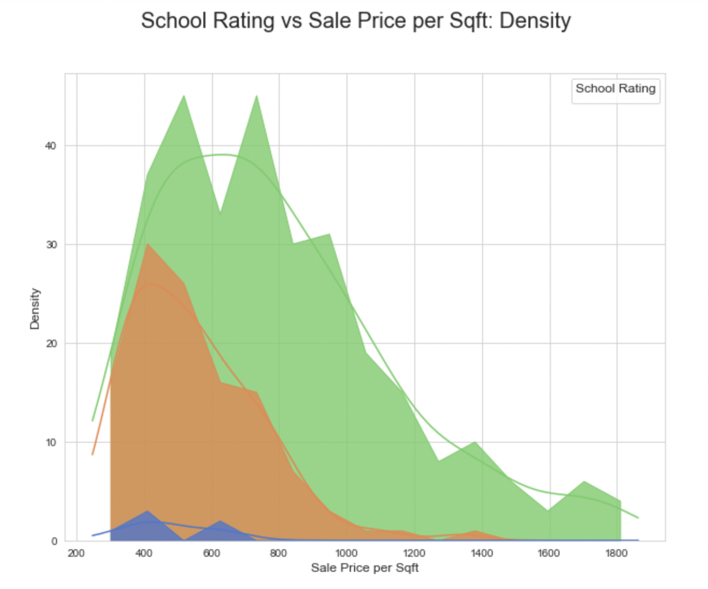
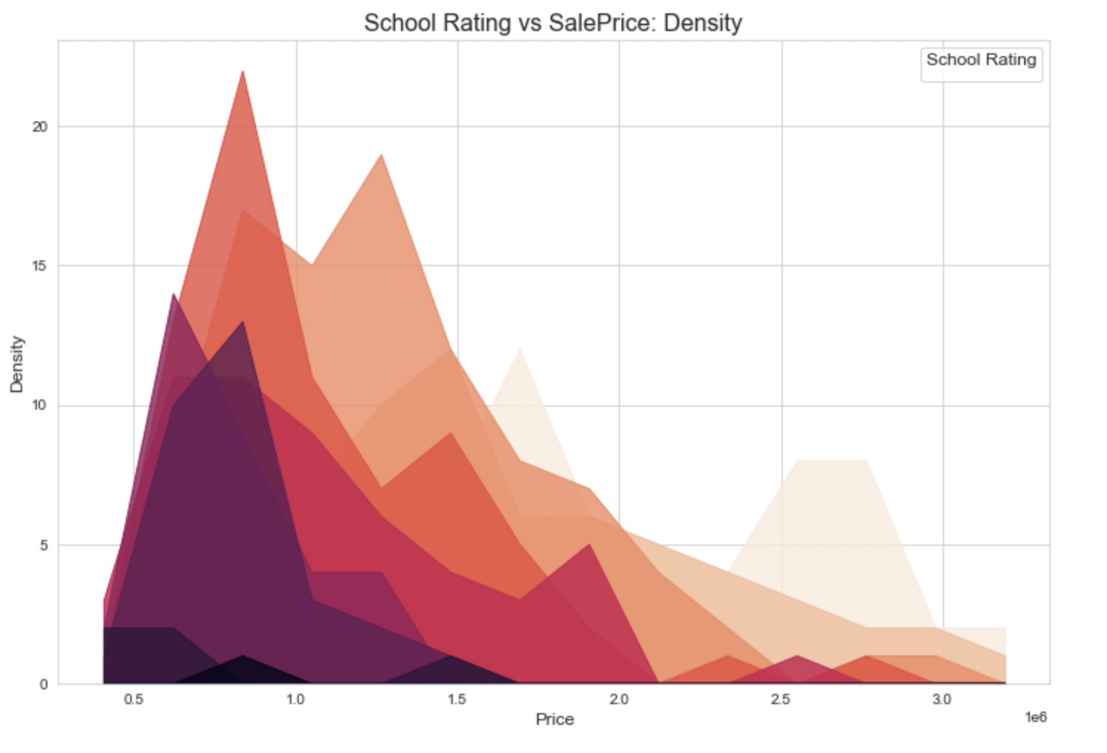

Slide 17
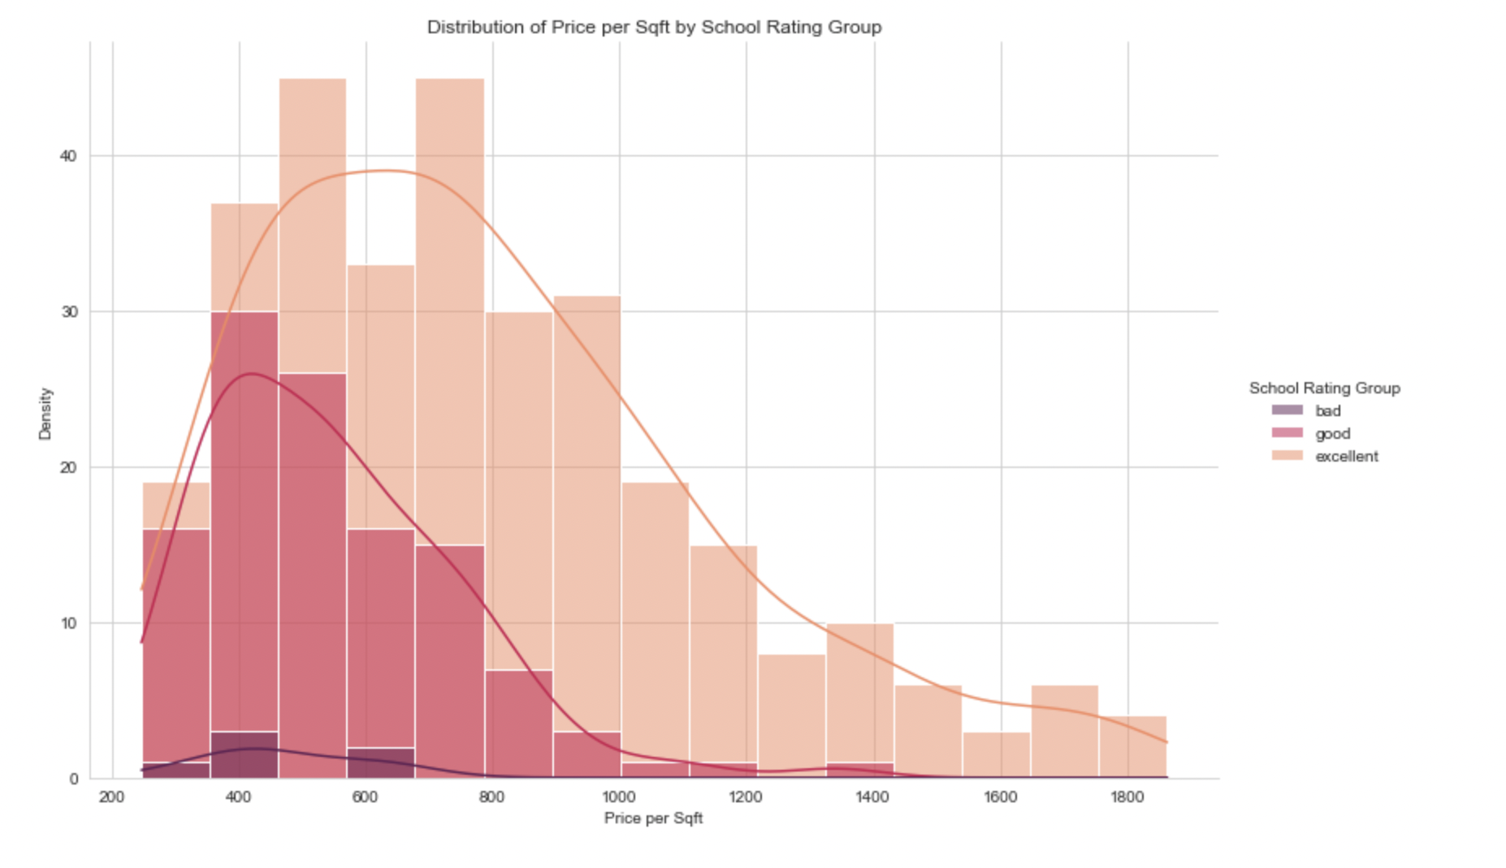
The prices of houses will vary based on the school rating group they fall into. Generally, houses in the "Excellent" school rating group will have the highest prices, followed by the "Good" group, and then the "Bad" group.
School ratings on a scale of 0-10 will be categorized into three groups: "Bad", "Good", and "Excellent".
School rating is an important variable in determining house prices, as houses in areas with better schools are typically more desirable and command higher prices.

Slide 18
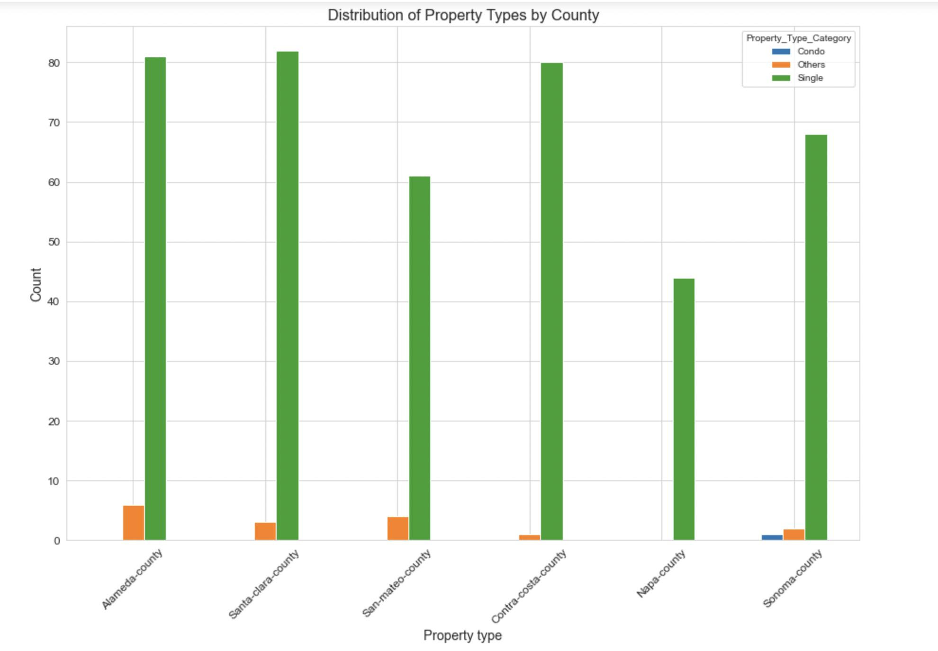

Slide 19
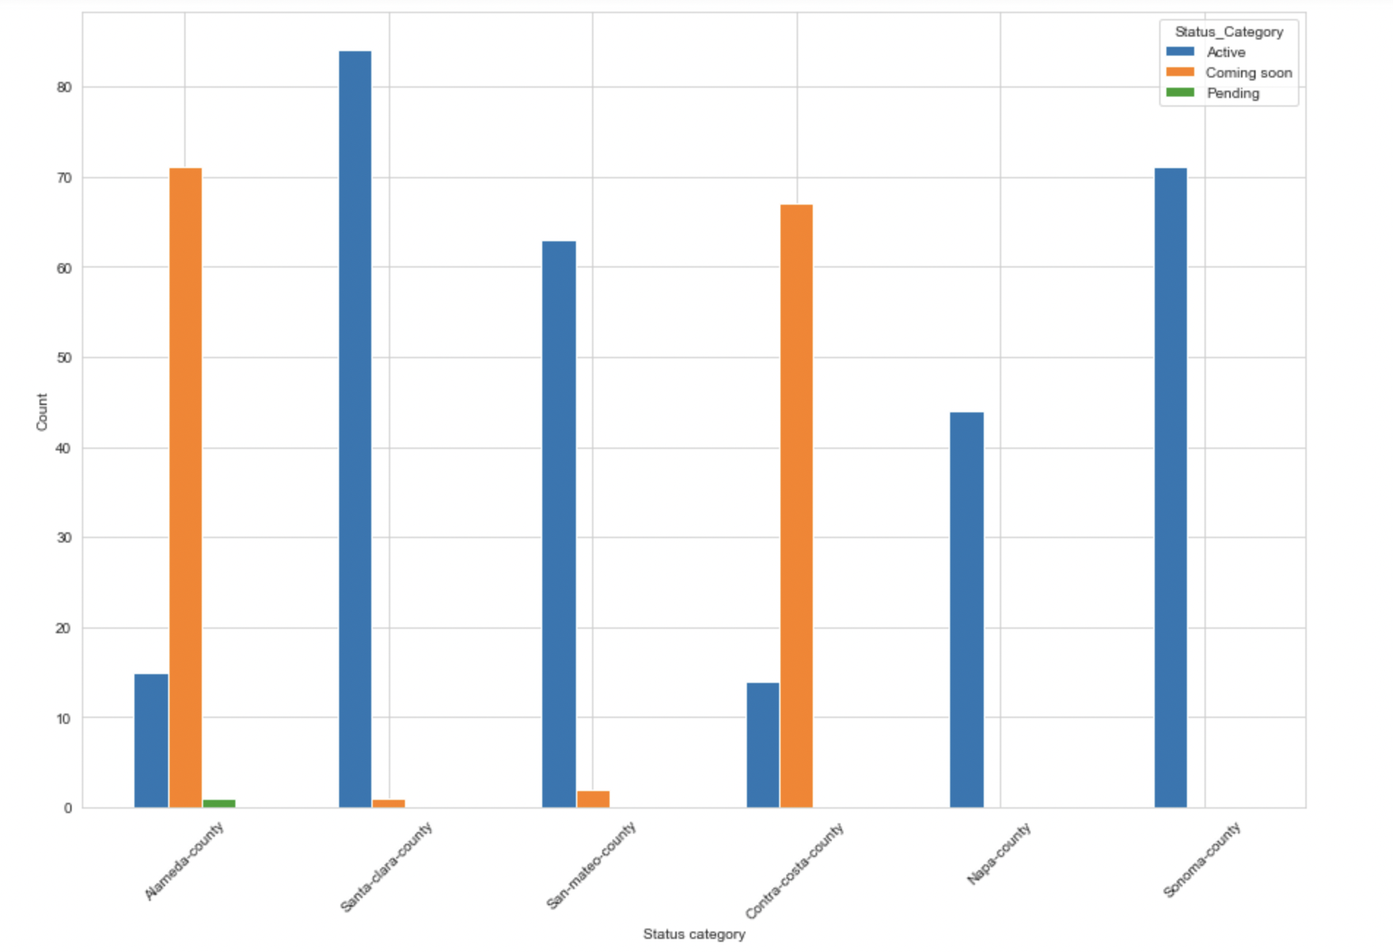

Slide 20
Predictive Analysis

Slide 21
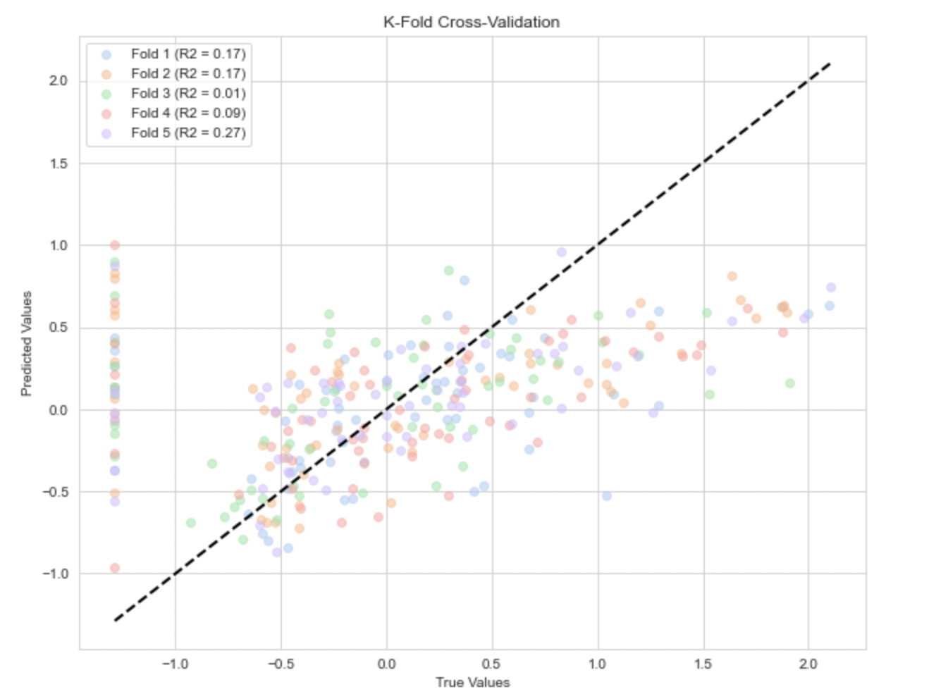

Slide 22
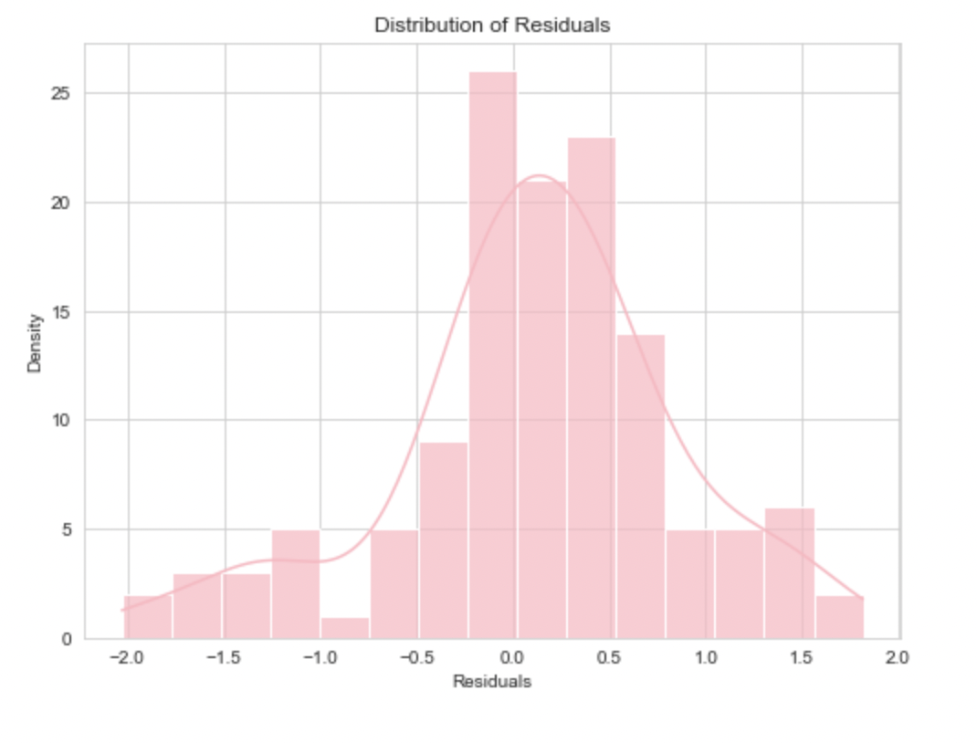

Slide 23
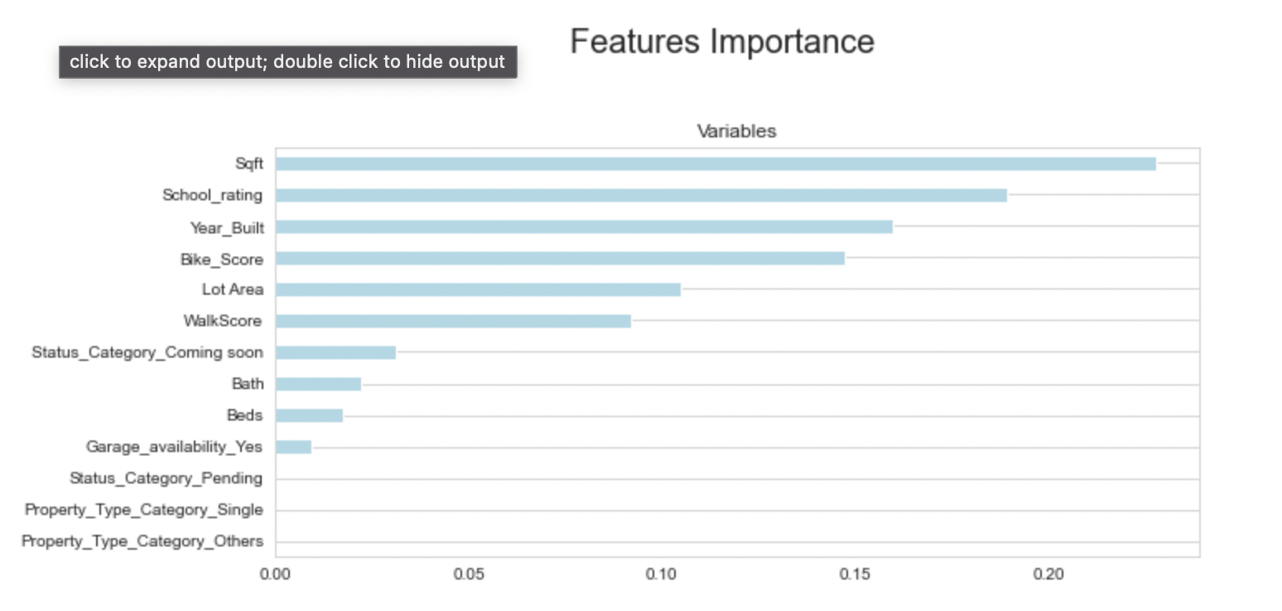
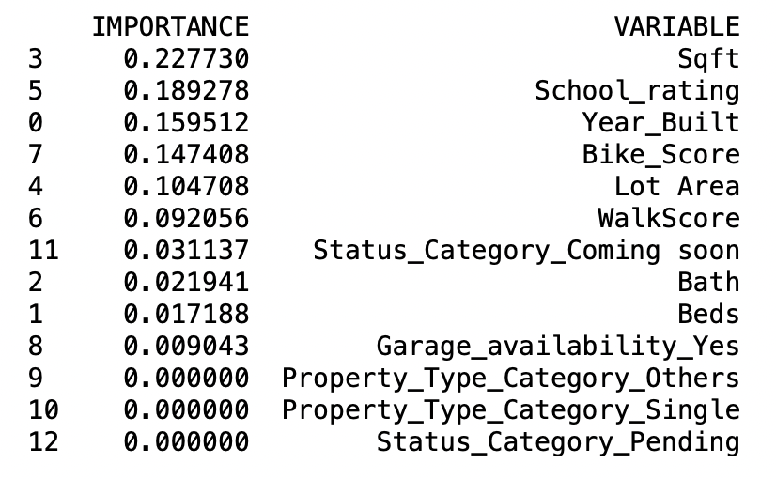

Slide 24
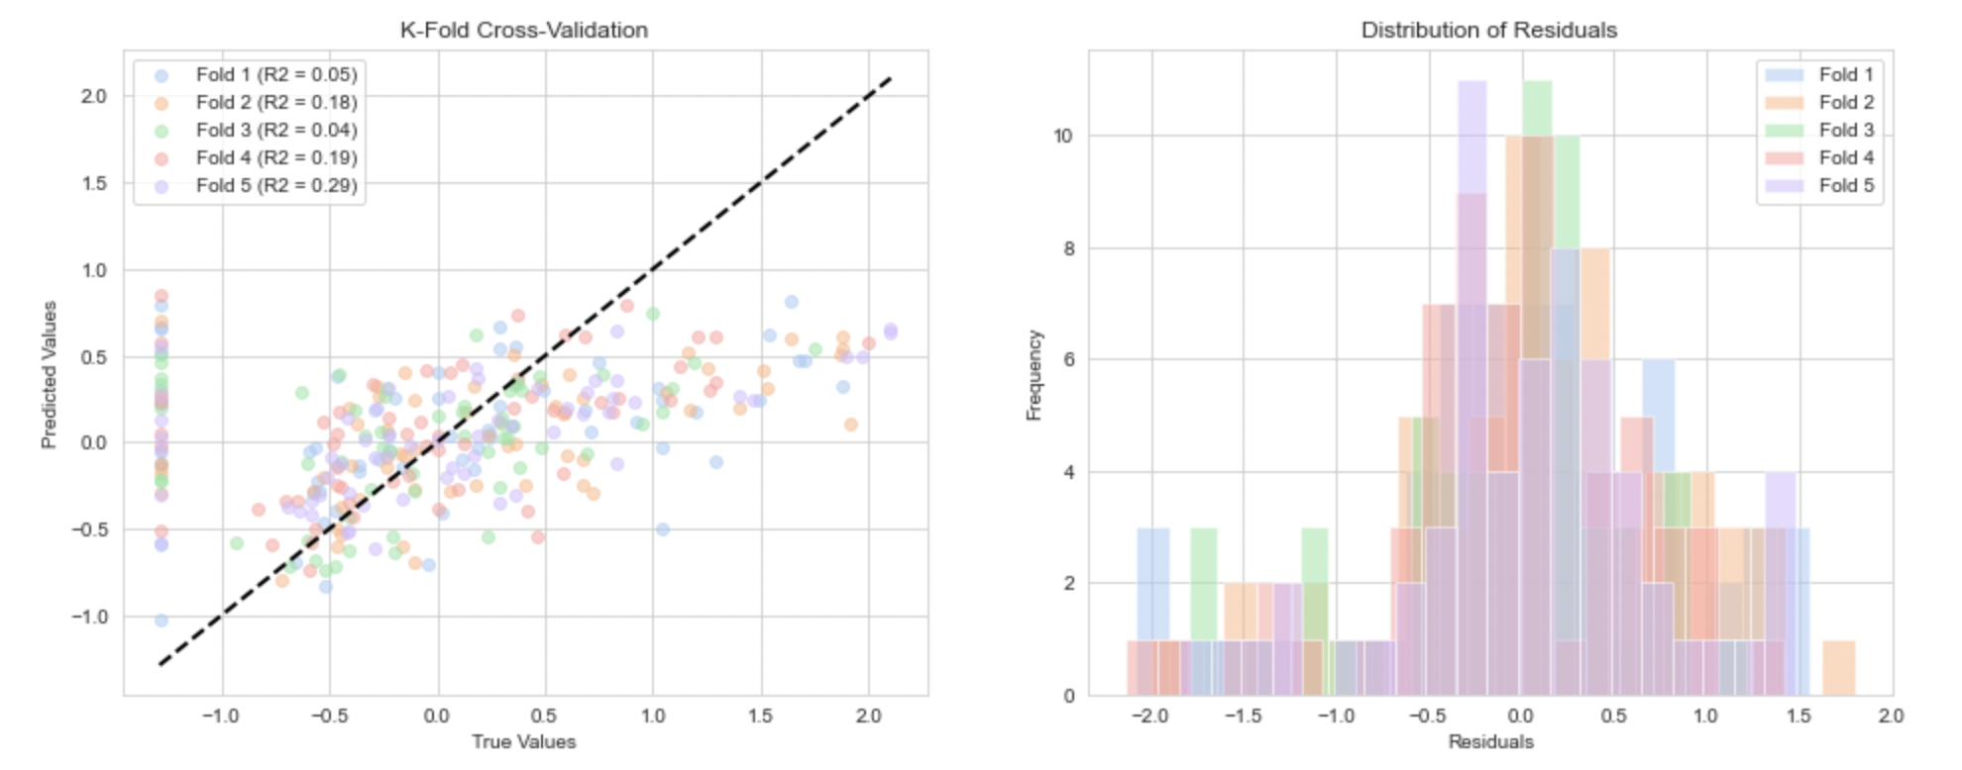

Slide 25
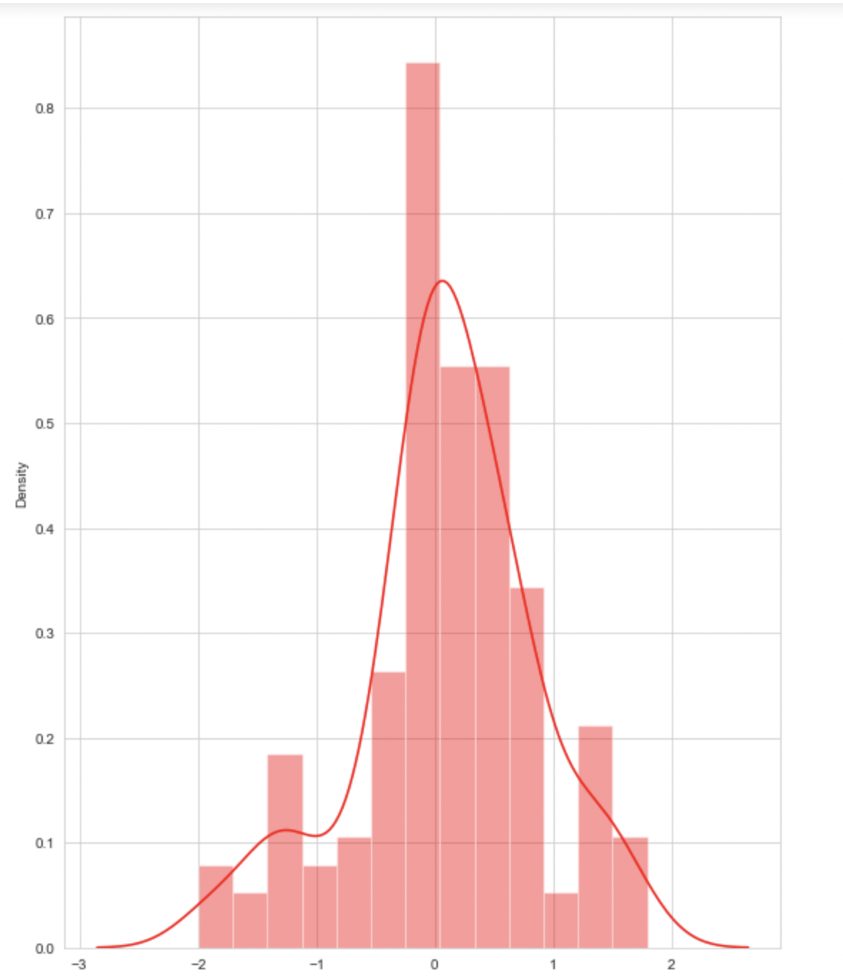
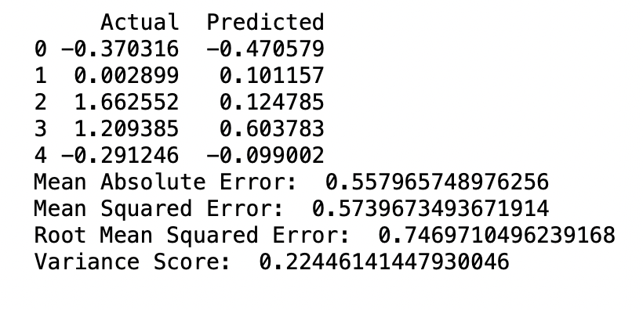

Slide 26
